Slide 1
Diamonds project
Prediction Project
shAI club

Slide 2
CONTENTS OF THIS TEMPLATE
#1 Look At The Big Picture
#2 Get The Data
#3 Discover and Visualize the Data to Gain Insights
#3.1 Discover the Data.
#3.2 Visualize the Data.
#4 Prepare the Data for Machine Learning Algorithms
#5 Select and Train a Model
#6 Fine-Tune Your Model

Slide 3
#1 Look At The Big Picture
“predict diamonds prices based on a pre given labeled dataset problem? Regression
Type of machine learning system?
Supervised / Unsupervised
Batch Learning / Online Learning
Instance Based / Model Based

Slide 4
1
Get the
data

Slide 5
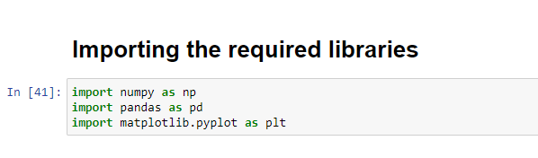
#2 Get The Data

Slide 6
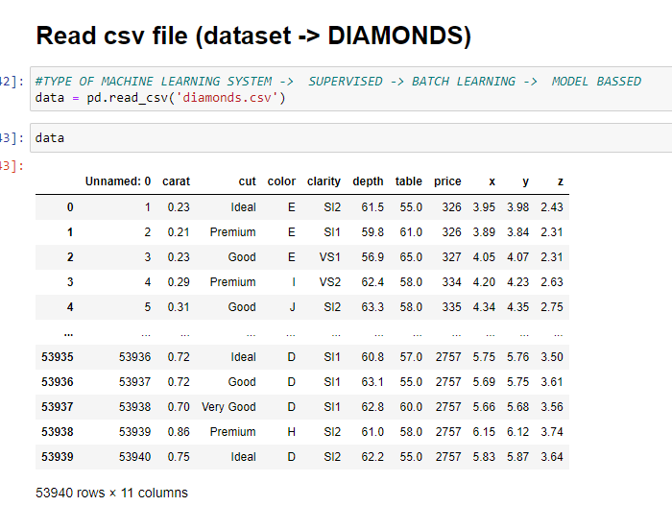
Read the data

Slide 7
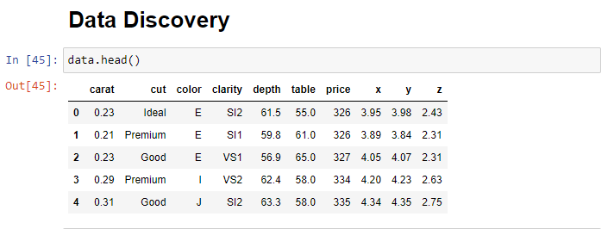

Slide 8
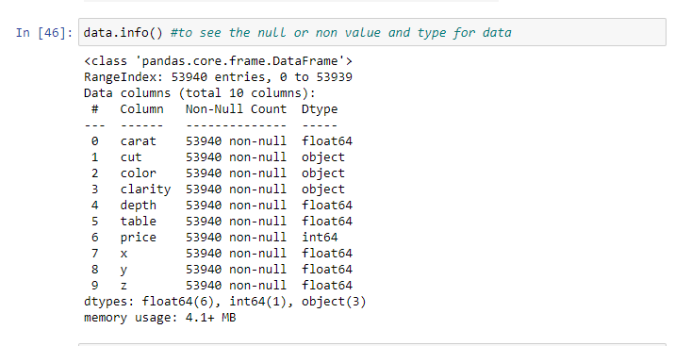
Notice that there are 53940 non-null values

Slide 9
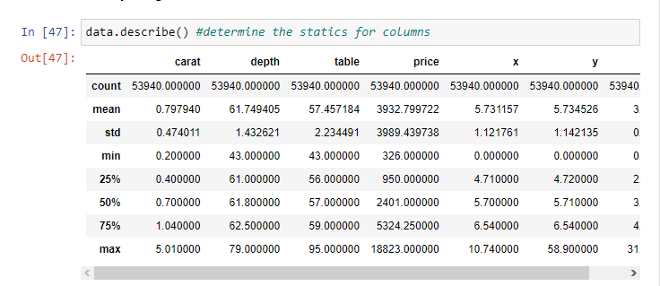
Let’s look at the other fields. The describe() method shows a summary of the numerical attributes:

Slide 10
2
Discover and
Visualize the
Data to Gain
Insights

Slide 11
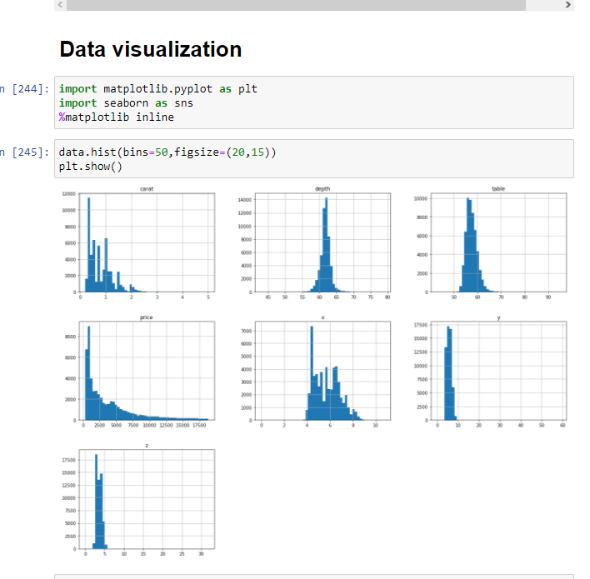
A quick way to get a general look at the data is plotting .
A histogram shows the number of instances (on the vertical axis) that have a given value range (on the horizontal axis).

Slide 12
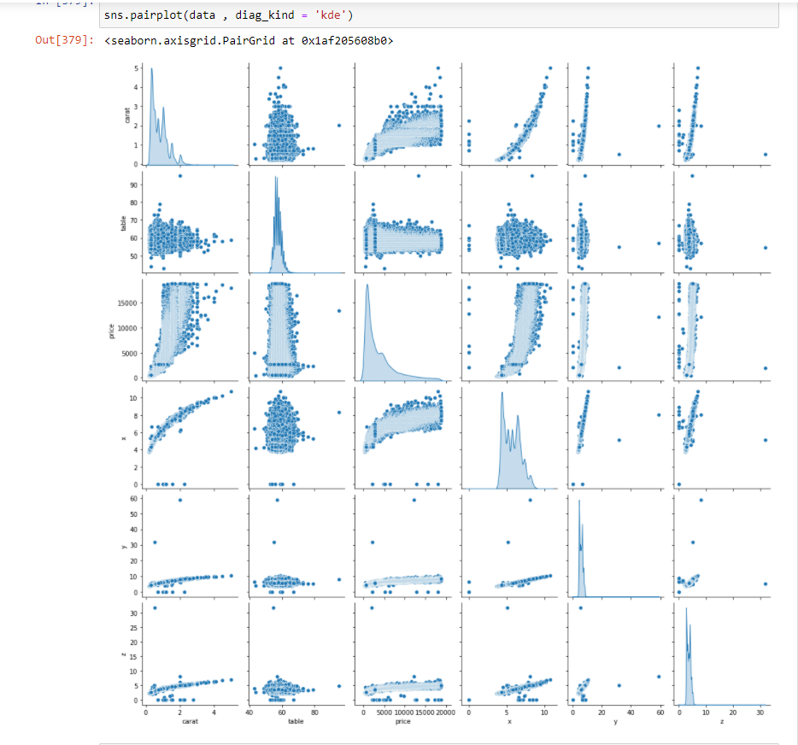
Plot pairwise relationships in a dataset.

Slide 13
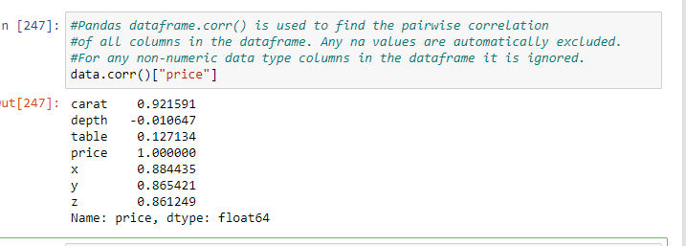
We noticed that the depth values haven’t a relation between price so let’s drop it

Slide 14
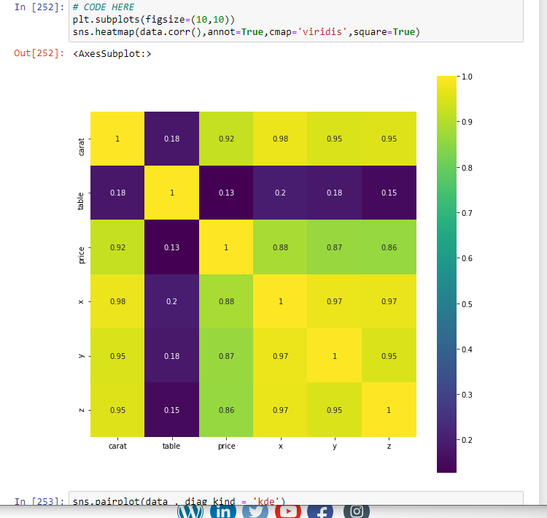

Slide 15
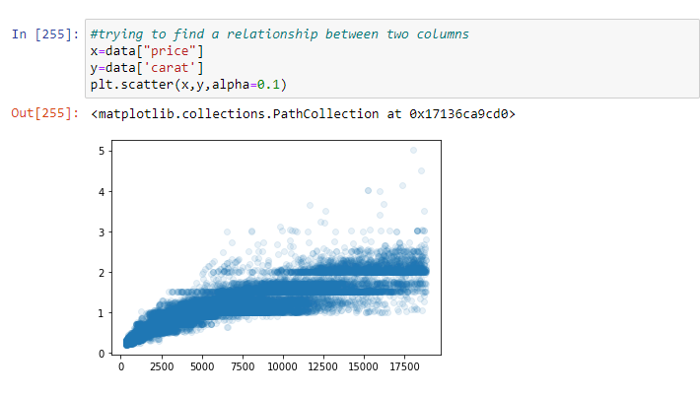
From correlation we noticed that the relation between price and carat is high equal 0.92 so the carat is very important

Slide 16
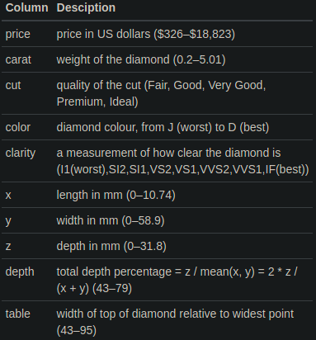
#3 Discover and Visualize the Data to Gain Insights
Depends on this picture we noticed that x , y , z
Are the length , width and depth so we can collect them in a one feature called “ volume”

Slide 17
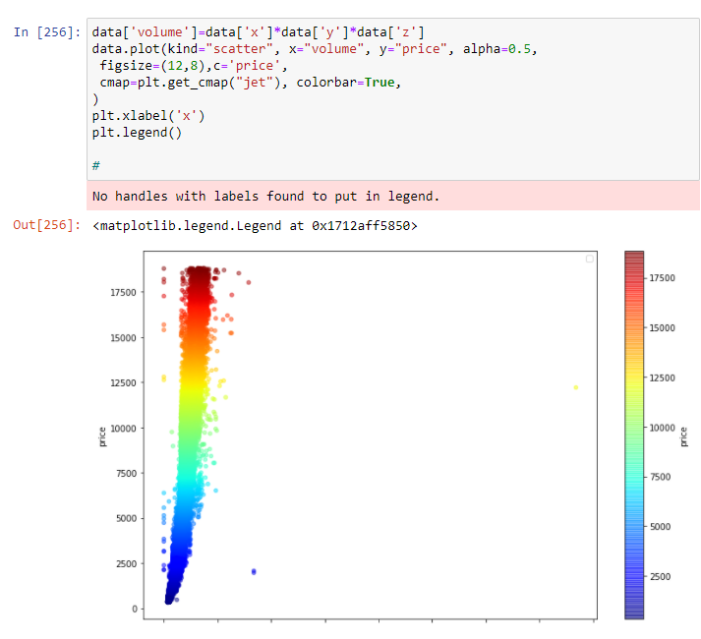
Visualizing Geographical Data Since

Slide 18
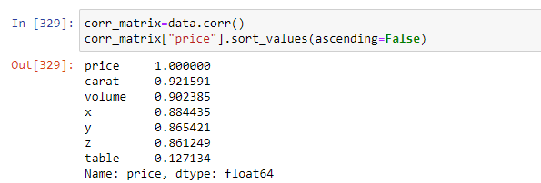
Let’s see the correlation between the new attribute ‘volume ‘ and price

Slide 19
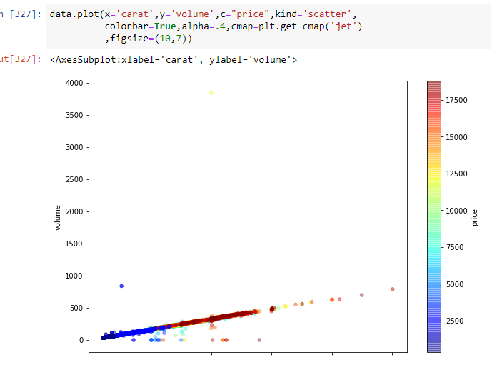

Slide 20
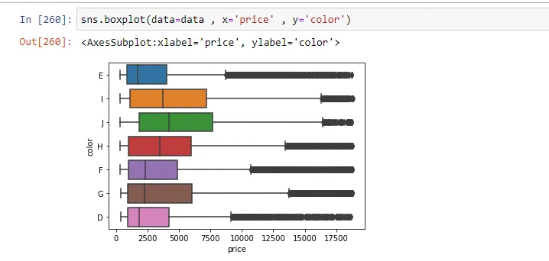

Slide 21
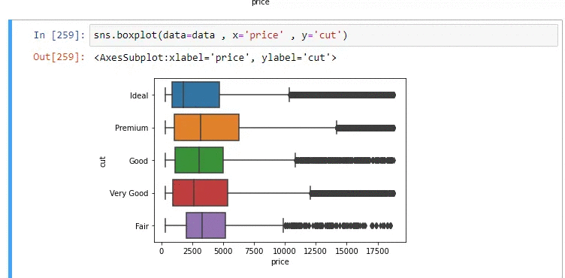

Slide 22
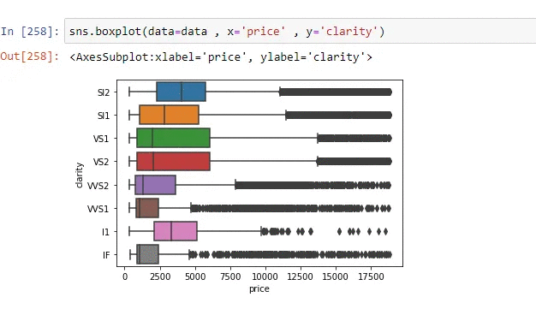

Slide 23
3
Prepare the Data for
Machine Learning
Algorithms

Slide 24
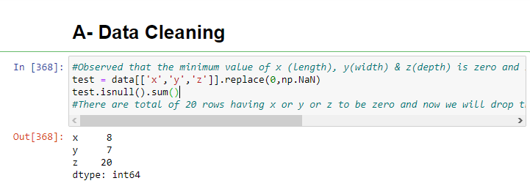
Checking for the missing values !

Slide 25
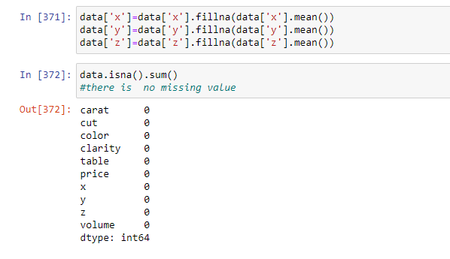
We filled the null values with the mean

Slide 26
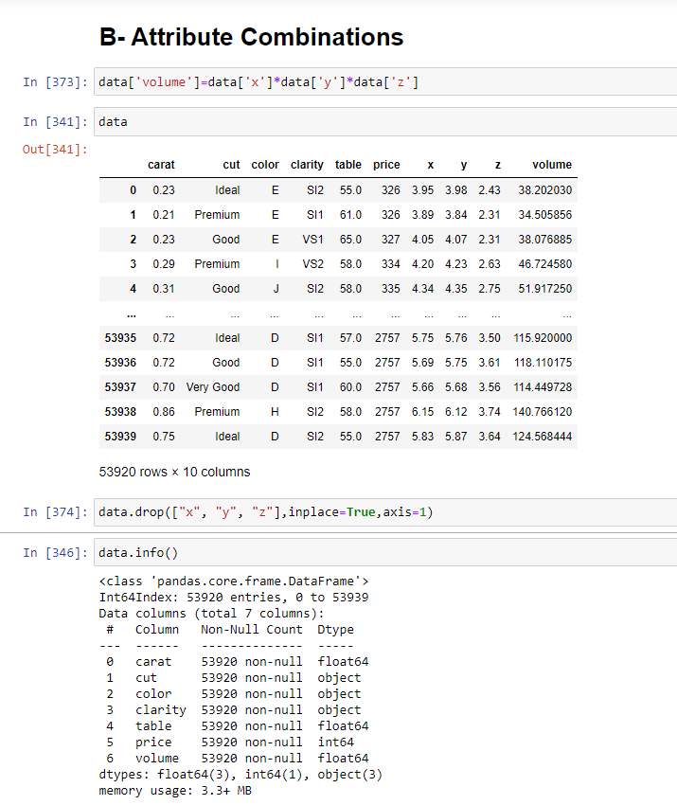
We dropped x , y , z attributes after combined them in volume

Slide 27
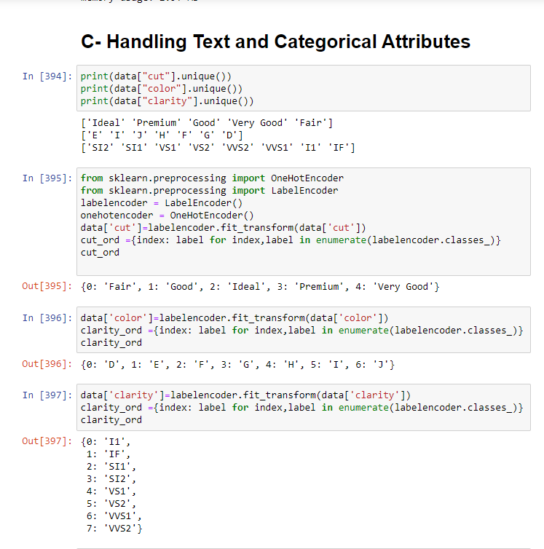

Slide 28
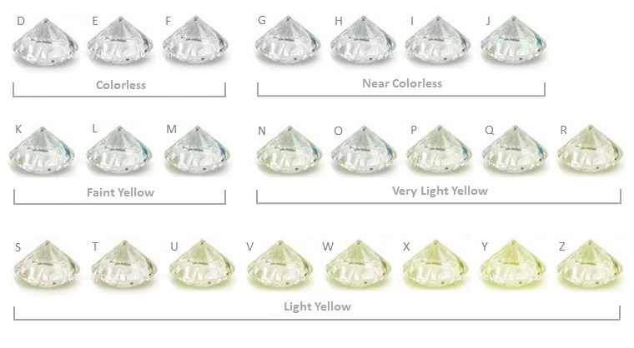
We noticed that diamond’s colors have near shadows so we used label encoder

Slide 29
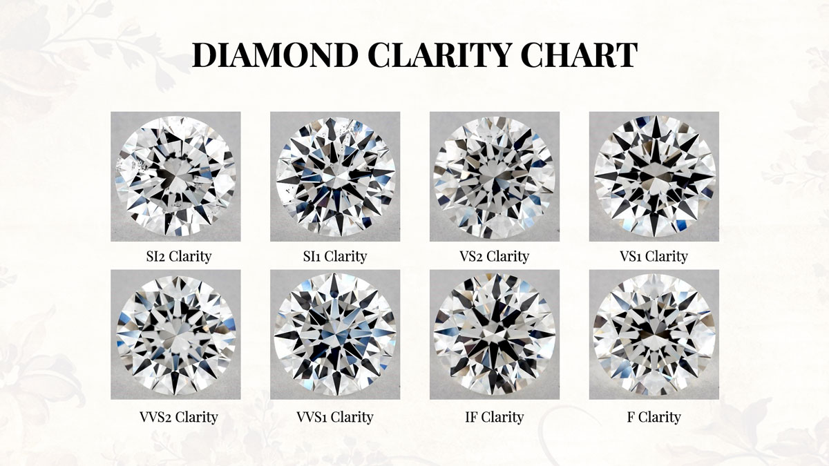
We noticed that diamond’s clarity have near shadows so we used label encoder

Slide 30
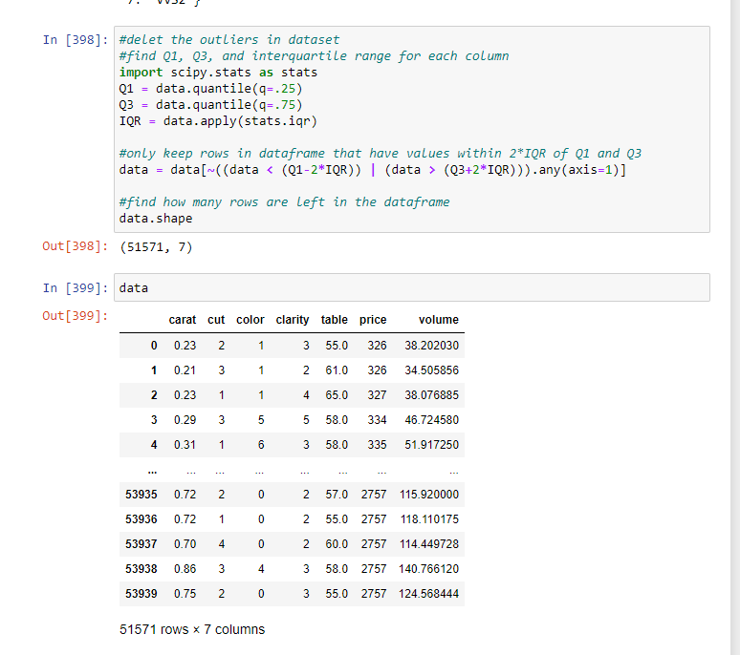
Delete the outliers from dataset

Slide 31
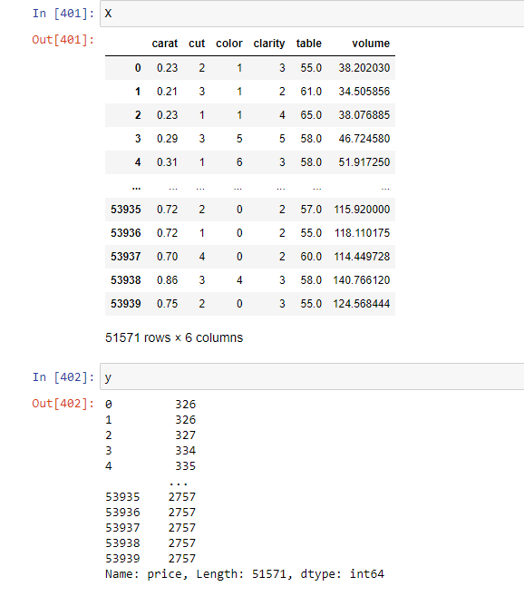
let’s separate the
predictors ( price (dependent variable [y]))
and the other attributes ( independent variable [ X ])

Slide 32
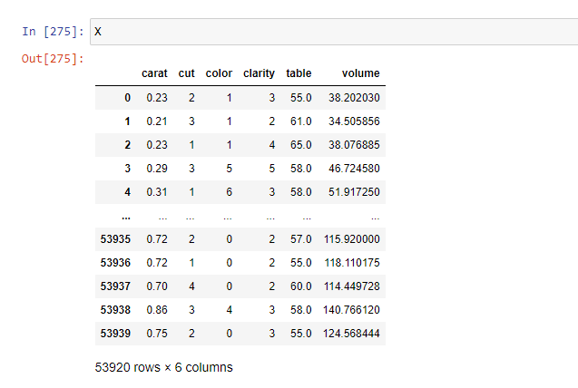
After applying LabelEncoder() on the data, the output will be a numerical values

Slide 33
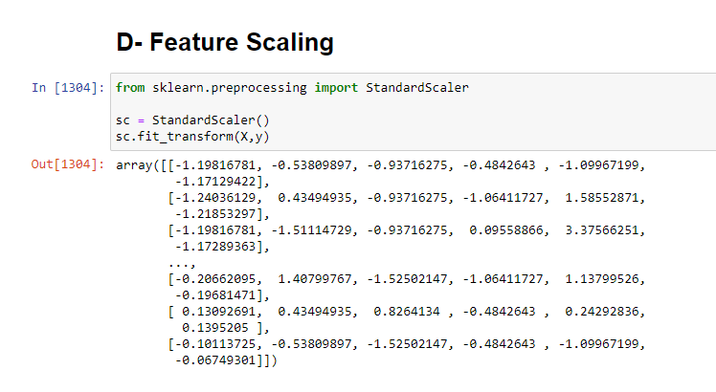
Depends on visualization we conclude that the range of the price is too far with regards to other attributes so we scaled it

Slide 34
4
Create a test set

Slide 35
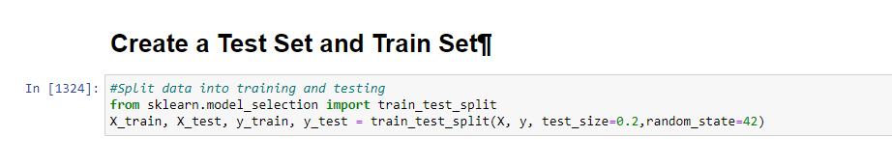
What is (random_state = 42) ? If you run the program again (without any random state ) the program will generate a different test set! So over time, the program will see the whole dataset, which is what you want to avoid. We set the random number generator’s seed ( random_state= 42), so it always generates the same test set.

Slide 36
5
Select & train the model

Slide 37
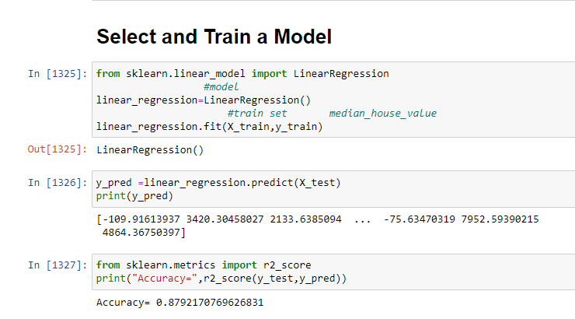
Linear Regression Model

Slide 38
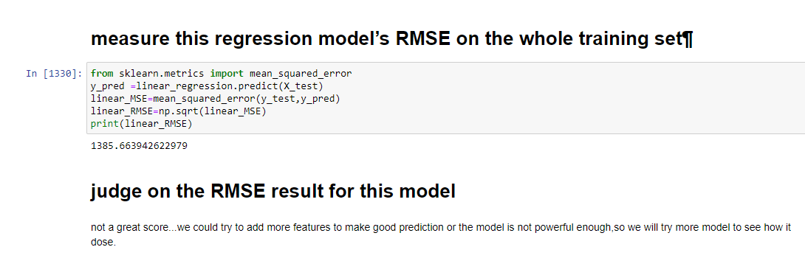

Slide 39
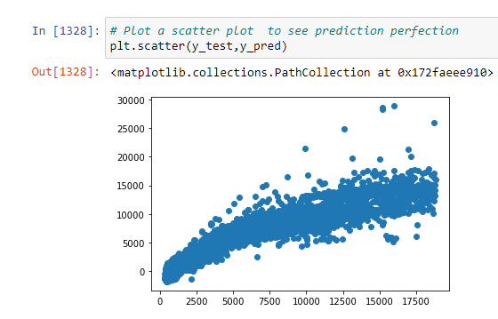

Slide 40
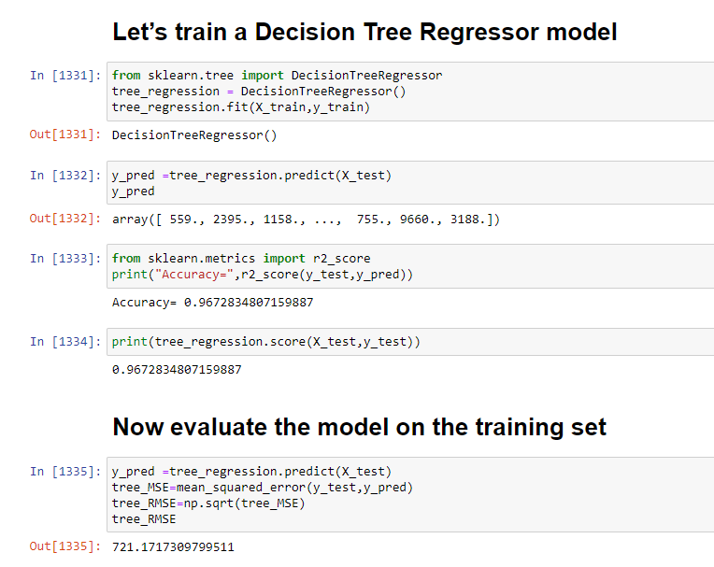
Decision Tree Regressor Model.

Slide 41
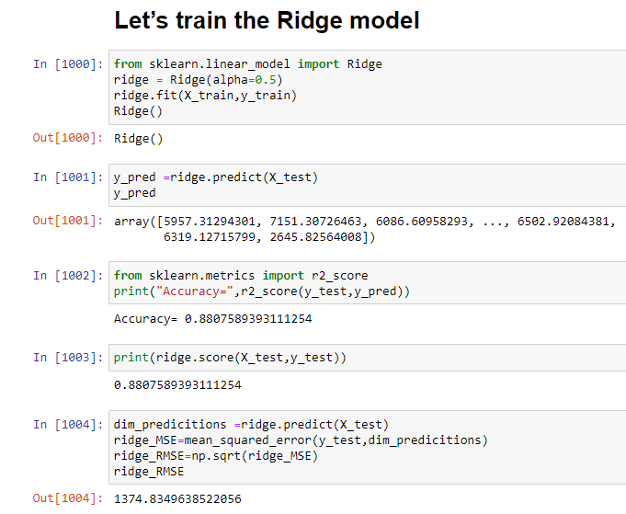
Ridge Model.

Slide 42
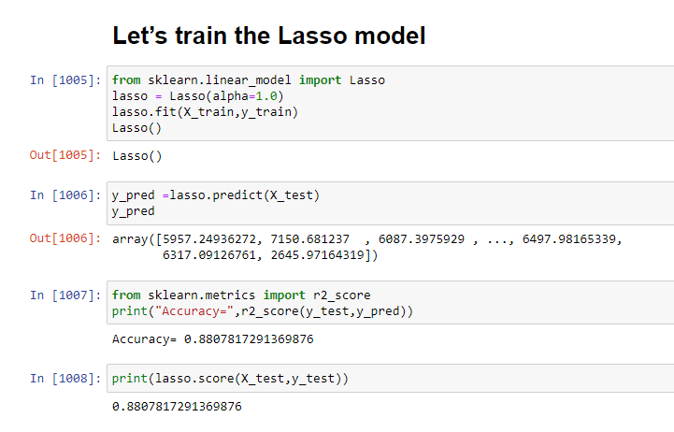
Lasso Model.

Slide 43
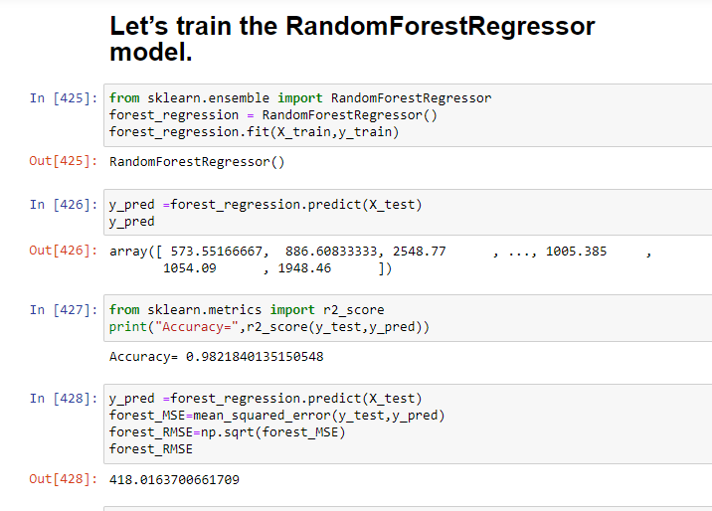
Random Forest Regressor Model.

Slide 44
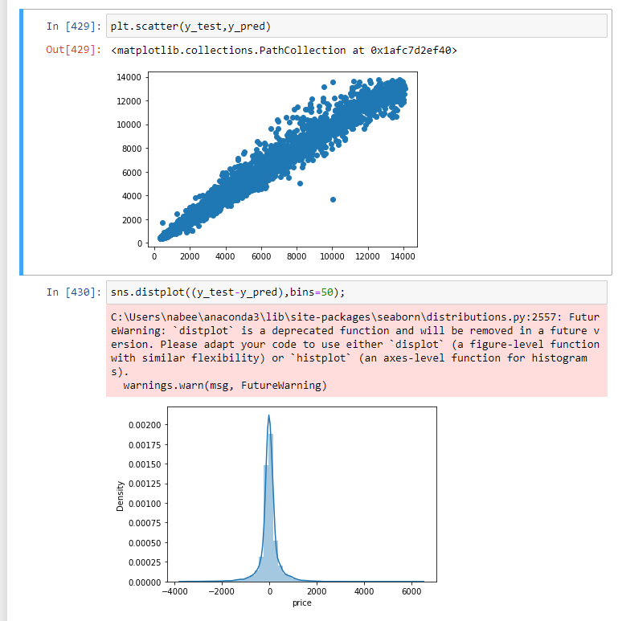

Slide 45
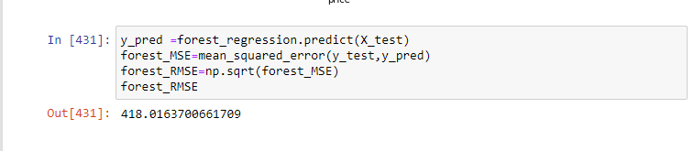
RMSE for the randomForestRegressor

Slide 46
We applied 5 models on data and we noticed that the best model was random forest regressor with an accuracy = 0.9821840135150548
And root mean square error (rmse) =
418.0163700661709
so we will make a copy of a model using grid search

Slide 47
6
Fine – tune your model

Slide 48
One way to do that would be to work on the hyperparameters manually, until you find a great
combination of hyperparameter values. This would be very tedious work, and you may not have
time to explore many combinations.
Instead, you should get Scikit-Learn’
s GridSearchCV to search for you.
All we need to do is tell it which hyperparameters you want it to experiment with, and what values
to try out, and it will evaluate all the possible combinations of hyperparameter values, using
cross-validation.

Slide 49
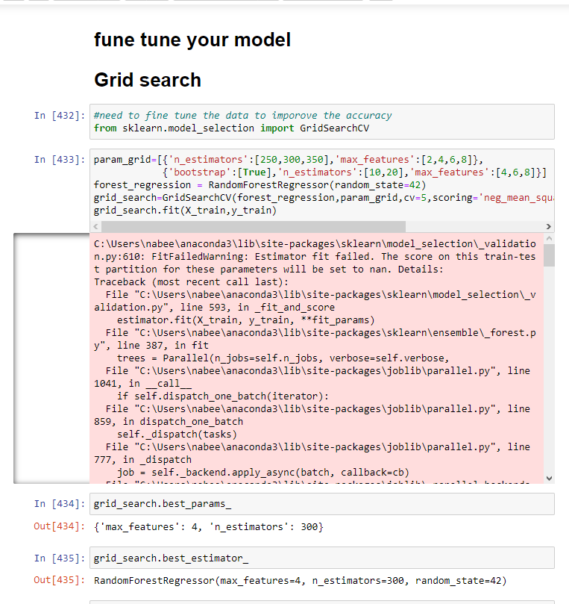

Slide 50
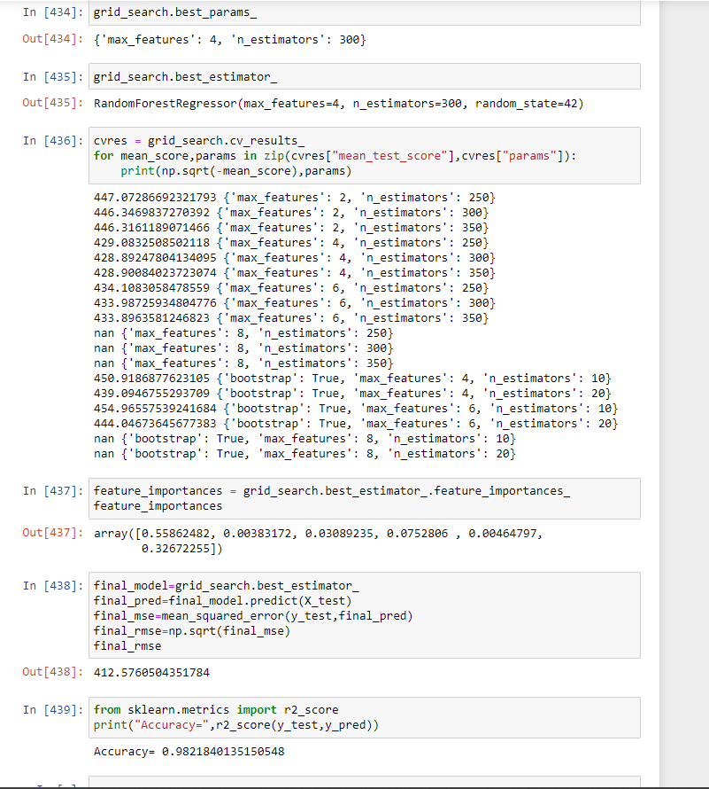

Slide 51
GridSearch result
Wow !
The rmse had become
412.5760604351784
Instead of 418.0163700661709
& the accuracy had become 0.9821840135150548 .

Slide 52
The end
Rama Marhlh
Juhayna Qatamin

Slide 53
